Slide 1




Session V. Showcasing IP Mediation

Slide 2

EUIPO Mediation Centre
Integrated IP dispute resolution
Karin Kuhl
Director – EUIPO Mediation Centre

Slide 3
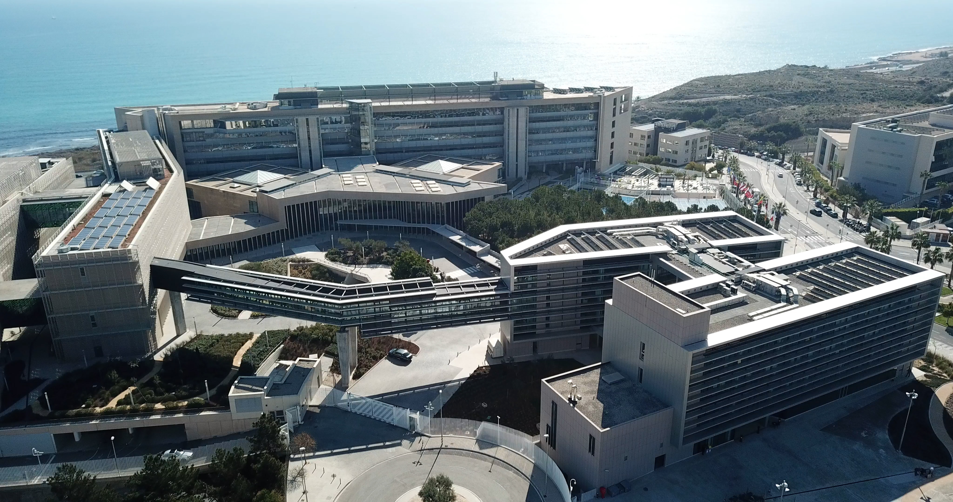
EUIPO MEDIATION CENTRE
  EUIPO Mediation Centre launched in November 2023
    Mediation at the appeal level since 2011
  Voluntary and confidential
  No additional cost
  Streamlined process (3 months)
  Mediations can be online, in Alicante or Brussels
  70% Settlement rate
  90% User satisfaction post-mediation

Slide 4









SCOPE OF MEDIATION SERVICES
  EU Trade Mark and Design disputes pending before the EUIPO
    + 23,000 inter partes proceedings annually
  Possibility to include in the mediation:
    Any other IP rights: copyright, domain names, patents…
    Any other parallel disputes pending between the same parties
    Anywhere in the world

Slide 5
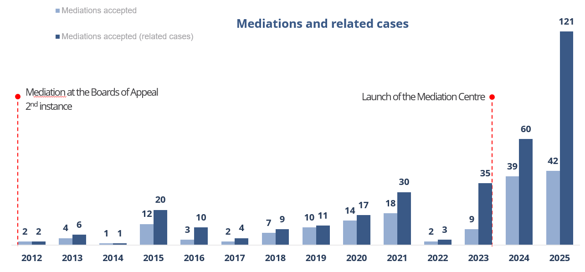
SCOPE OF MEDIATION SERVICES
Resolving multiple disputes within a single process
On average, 1 mediation closes 3 related proceedings
Greater efficiency

Slide 6
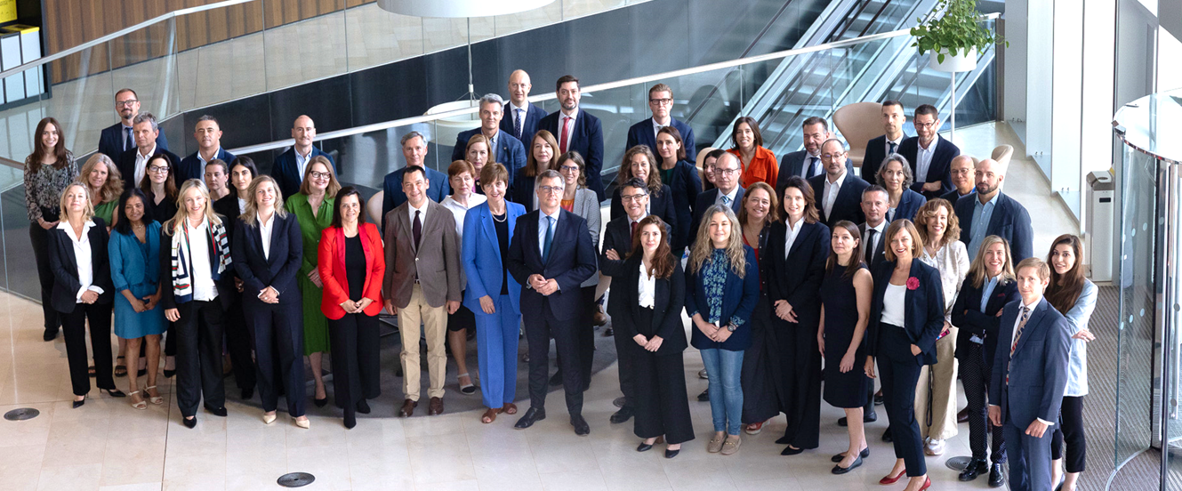
EUIPO MEDIATORS' COMMUNITY
  Multilingual EUIPO experts in IP disputes
  Accredited by internationally recognised mediation institutions
  Continuous training and professional coaching to ensure quality
  Appointed by the parties with assistance from the Centre
    Language
    Nationality
    Expertise
    No conflict of interest

Slide 7
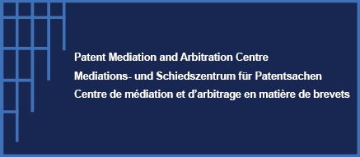
Patent Mediation and Arbitration Centre (PMAC)
Aleš Zalar
Director of the PMAC

Slide 8
SCOPE OF THE PMAC’S COMPETENCE
Article 35(2) UPCA: "The Centre shall provide facilities for mediation and arbitration of patent disputes falling within the scope of this Agreement. […]“
Rule 5(1) Rules of Operation of PMAC: "The objective of the Centre is to promote mediation and arbitration in cases which fall wholly or in part within the competence of the UPC.“
Article 2 Mediation Rules of PMAC: “The Mediation service of the Centre offers support in the settlement of disputes relating to European patents, European patents with unitary effect and supplementary protection certificates for which UPC is competent pursuant Article 32 of the UPCA and Related disputes.”
“Related Disputes” means, by way of example, disputes involving other national patents, international patents or patent applications, or portfolios of the same, whether or not the patent rights in question are European patents, European patents with unitary effect or supplementary protection certificates and/or any other intellectual property or commercial disputes, as long as there is a factual, legal or commercial nexus with an actual or contemplated dispute concerning a European patent, a European patent with unitary effect, or a supplementary protection certificate for which the UPC is wholly or in part competent.
Notes:
8

Slide 9
REFERRAL TRACKS
Court referrals
Article 52(2) UPCA requires judges to "explore with the parties the possibility for a settlement, including through mediation, and/or arbitration."
Rule 11 Rules of Procedure further promotes this settlement exploration: “At any stage of the proceedings, if the Court is of the opinion that the dispute is suitable for a settlement, it may propose that the parties make use of the facilities of the Patent Mediation and Arbitration Centre (“the Centre”) in order to settle or to explore a settlement of the dispute. […]“
Institutional referrals
EPO in cases of oppositional proceedings
national courts in cases linked to the European patent, European patent with unitary effect
National Intellectual Property Offices
Marketplace referrals
Contractual Clauses
Dispute Submission Agreements
ADR Agreements
Notes:
9

Slide 10
PMAC’S SERVICES
Mediation
Arbitration
Expert determination services
+ hybrid process combinations (med-arb, arb-med, med-arb-med)
Early neutral evaluation
Notes:
10

Slide 11
PMAC’S CORE BENEFITS
✅ ADR information sessions
✅ Multi door dispute resolution policy approach - many roads to justice
✅ General Procedural flexibility, tailored to the needs and interests of the parties in IP disputes
✅ No limitation in geographical scope
✅ Time and costs savings:
Online proceedings
Expedited procedures
Fee structure and SME support + Financial incentives for early settlement
✅ Expertise of neutrals
✅ Specialized procedural provisions for SEP/FRAND
✅ Unique enforceability regime
Notes:
11

Slide 12

WIPO Arbitration and Mediation Center
Chiara Accornero
Legal Officer , World Intellectual Property Organization – WIPO

Slide 13
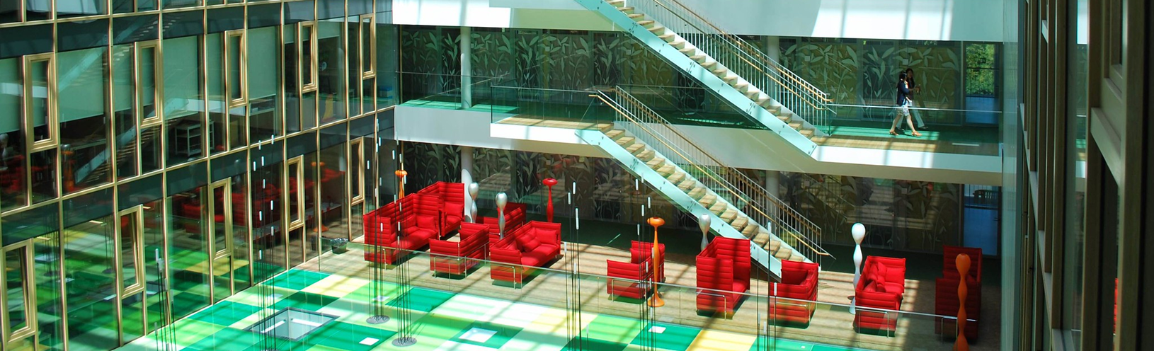
WIPO Arbitration and Mediation Center
  IP- and innovation-related commercial disputes
  Global, neutral and specialized (over 2,500 WIPO mediators, arbitrators and experts experienced in IP and technology)
  Offices in Geneva and Singapore and WIPO Shanghai Service
  Mediation, arbitration, expedited arbitration, expert determination and domain name disputes

Slide 14


Our role
Procedural assistance (Good Offices)
  information and guidance on ADR
  drafting mediation and arbitration clauses and submission agreements
Administering cases
  containing time and costs
  WIPO online tools
Assisting selection of mediators, arbitrators, experts; negotiating fees
  2,500+ mediators and arbitrators from all regions
  specialized in IP and technology

Slide 15
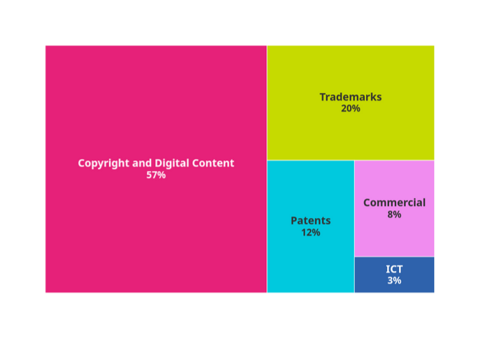

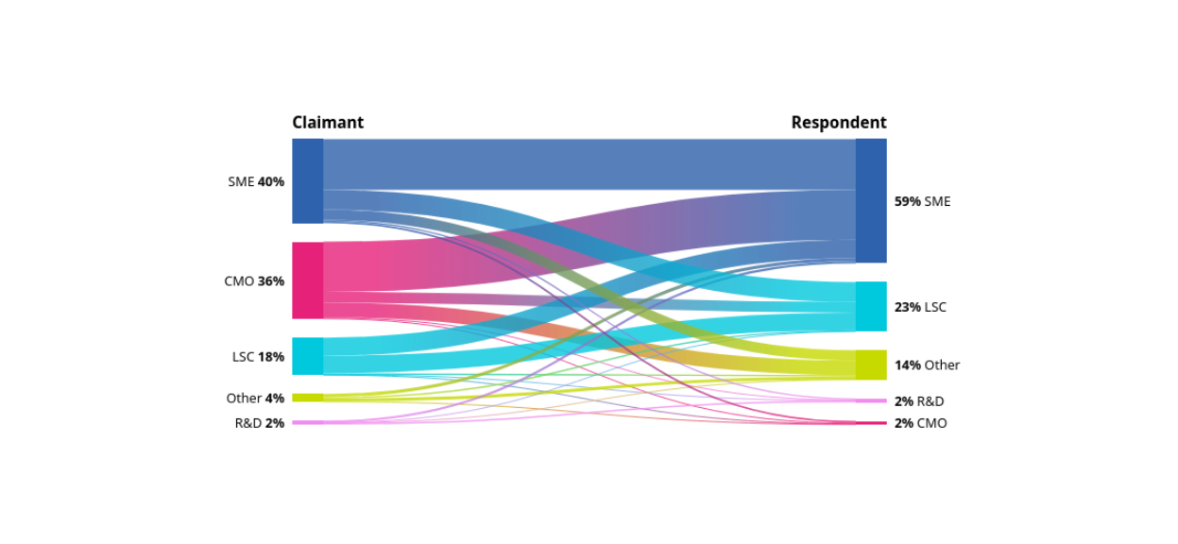


Legal Areas
Party Location
North America
20%
Europe
39%
Africa
2%
Asia Pacific
31%
LAC
9%
Settlement rate
Type of Parties
70%
33%
WIPO
Mediation
WIPO
Arbitration

Slide 16

WIPO ADR Collaboration with IP Offices and Courts
United States of America: USPTO
Canada: CIPO
EAPO Member States
GCC-SG Member States
China: CNIPA, SHPC, Ministry of Justice
Georgia: SAKPATENTI
India: CGPDTM
Indonesia: DGIP
Israel: ILPO
Kazakhstan: Ministry of Justice
Kyrgyzstan: Kyrgyzpatent
Philippines: IPOPHL
Qatar: Ministry of Commerce and Industry, QICDRC
Republic of Korea: KIPO, MCST,
Ministry of Justice, Patent Court
Saudi Arabia: SAIP
Singapore: IPOS, Ministry of Communications and Information,
Ministry of Law
Thailand: Central IP and
International Trade Court
Türkiye: TURKPATENT
Albania: GDIP, Magistrate School
Austria: Austrian Patent Office
Belarus: NCIP
Bulgaria: BPO
Czech Republic: IPO CZ
France: INPI, Tribunal judiciaire de Paris
Greece: HCO
Hungary: HIPO
Italy: UIBM
Lithuania: Ministry of Culture
Poland: PPO
Romania: ORDA
Russian Federation: ROSPATENT
Serbia: IP Office
Slovakia: IPO SK
Spain: Ministry of Culture
and Sports, OEPM
Switzerland: IPI
Ukraine: MEDT
United Kingdom: UK IPO
Europe
North America
Asia
Costa Rica: National Register
Cuba: OCPI
Dominican Republic: ONDA
El Salvador: CNR
Guatemala: RPI
Mexico: IMPI, INDAUTOR
Trinidad and Tobago: TTIPO
Argentina: DNDA, INPI
Brazil: INPI
Chile: INAPI
Colombia: DNDA, SIC
Ecuador: SENADI
Paraguay: DINAPI, Supreme Court of Justice
Peru: INDECOPI
Uruguay: DNPI
Algeria: INAPI, ONDA
Botswana: CIPA
Egypt: Ministry of Justice
Kenya: KECOBO
Morocco: OMPIC
Namibia: BIPA
Nigeria: NCC, Patents and Designs Registry, Trademarks Registry
Tanzania: COSOTA, Judiciary of Tanzania
Uganda: URSB
Africa
Latin America and the Caribbean
Australia: IP Australia
New Zealand: IPONZ
Oceania

Slide 17

Non-judicial mediation in IP disputes a new service of the State Patent Bureau
Asta Virbickienė
Head of the Appeals Division

Slide 18


Mediation at the Lithuanian Patent Office
The Lithuania’s Patent Office launched its mediation services in 2024
  Legal basis: „Rules of non-judicial Mediation at the State Patent Bureau of the Republic of Lithuania“
  Applicable to disputes involving:
    Trade mark oppositions
    Trade mark invalidations
    Trade mark revocations
    Design oppositions
  Duration of mediation: 2 to 12 months
  Free of charge
  Voluntary and confidential

Slide 19

Mediation at the Lithuanian Patent Office
Requirements for becoming a Mediator
  48 hours of training
  To pass general mediators’ exam
  Inclusion in the list of mediators of the Republic of Lithuania
  Membership in the Lithuanian Chamber of Mediators
  There are two mediators in the Patent Office
      The parties have a right to choose the mediator
      The mediator is not permitted to later adjudicate the dispute
      The parties themselves must draft the settlement agreement

Slide 20
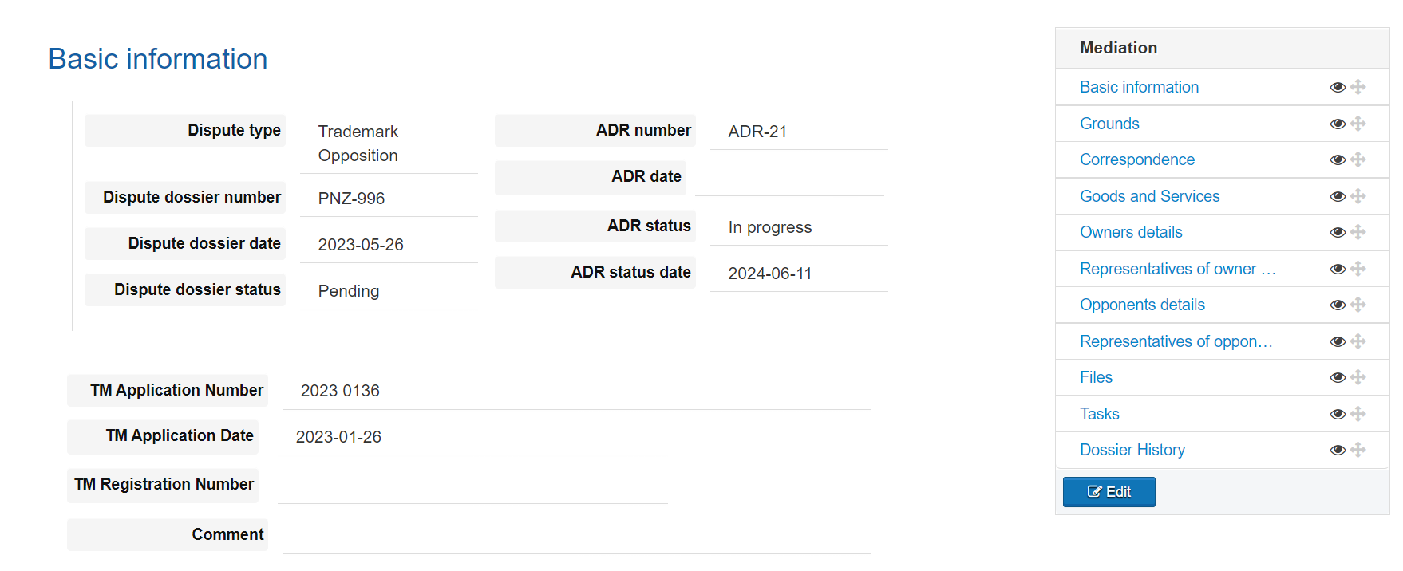
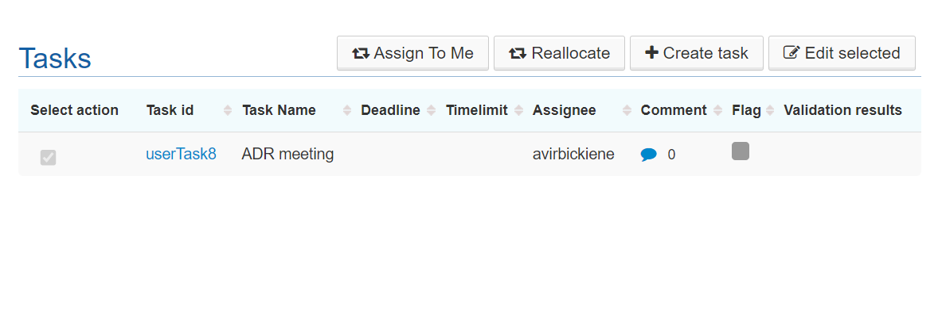
The mediation process is implemented in the BackOffice trade mark system
Plan 2025:
  Implementation of the mediation process in the design database in the BackOffice

Slide 21

Mediation at the Lithuanian Patent Office
From 2024 to 2025:
81 mediation proposals were sent to the parties
In 25 cases, the proposals were accepted by both parties or the parties themselves initiated mediation. Of these:
  15 mediations were successfully completed
  4 mediations did not result in a peaceful agreement
  6 mediations are still ongoing
Strategic goal for 2024–2025:
  To achieve a rate of 10% of mediations out of the total number of opposition, invalidity, and cancellation requests

Slide 22

Introduction to MOIP’s
Industrial Property Dispute
Mediation Committee
(focus on IPTAB-connected Mediation)
Siyoung PARK
Presiding Administrative Patent Judge / Intellectual Property Trial and Appeal Board (IPTAB)

Slide 23
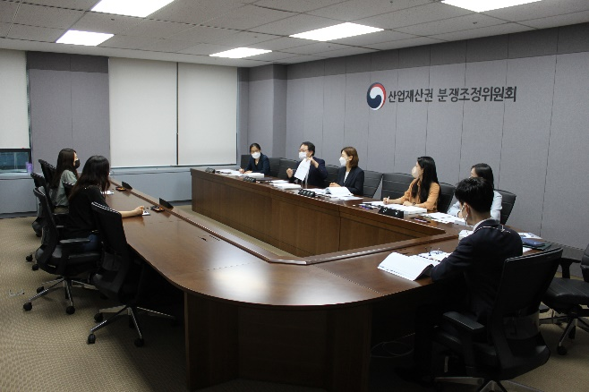
Overview of MOIP’s Mediation Committee
What’s Industrial Property Dispute Mediation Committee?
Established in accordance with the 「Invention Promotion Act」 for quick and amicable settlement of IP disputes, such as industrial property rights (since 1995)
Mediation Case Examples
Disputes over industrial property rights
(patent, trademark, design, utility model)
 Disputes over employee inventions
 Disputes over trade secrets
 Disputes over unfair competition
▲ Industrial Property Dispute
Mediation Committee
- 1 -

Slide 24
Overview of MOIP’s Mediation Committee
Mediation Effect
Effective as judicial mediation
→ Same effect as the final judgement (Res Judicata)
Mediation Procedure
Mediation
proposal
Request for mediation
Confirm the consent of the parties to mediate
Agree
Hold a mediation meeting
Accept
Mediation settled
Reject
Mediation failed
Refuse
3 Months
- 2 -

Slide 25


Overview of MOIP’s Mediation Committee
Qualifications for Committee Members
Public officials (Grade III or Senior Executive Service) of the KIPO
Judge or Prosecutor
Attorney-at-law or Patent Attorney
Persons in the position of an associate professor or higher at a university
Persons recommended by non-profit private organizations
By Professions
Patent Attorney | Lawyer (Attorney–at-law) | Government official | Total
50 | 29 | 1 | 80
Committee Members : By Expertise
Govt | Trademark, Design | Patent (Utility model) |  |  |  | Legal (Trade Secrets, Unfair Competitions) | Employee Inventions | Total
 |  | Machinery, Metals | Chemical, Biotechnology | Electrics, Electronics | ICT
1 | 19 | 11 | 7 | 5 | 5 | 27 | 5 | 80
Based on the expertise of its members in each case, a mediation panel of 1 to 3 members is formed to conduct highly professional mediation
- 3 -

Slide 26
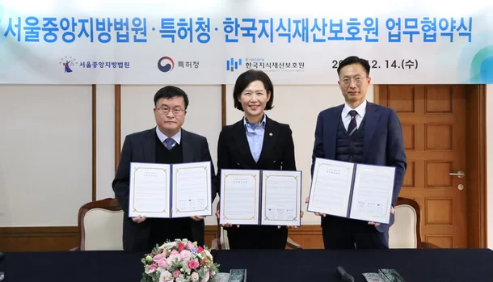
Cooperation with Court/IPTAB
Court-connected Mediation (2023~)
Committee Secretariat
☞ Seoul Central District Court-KIPO-KOIPA
Memorandum of Understanding (Dec 2022)
▶ Procedure
Settled
Hold a mediation meeting
Notify mediation result
Same effect
as judicial mediation
Refer a case to committee
Re-litigate the case
Court
Committee
Committee
Failed
Court
Other Relevant Procedures
▶ Prosecutor’s Office-connected Mediation (2015~)
▶ IPTAB-connected Mediation (2022~)
- 4 -

Slide 27
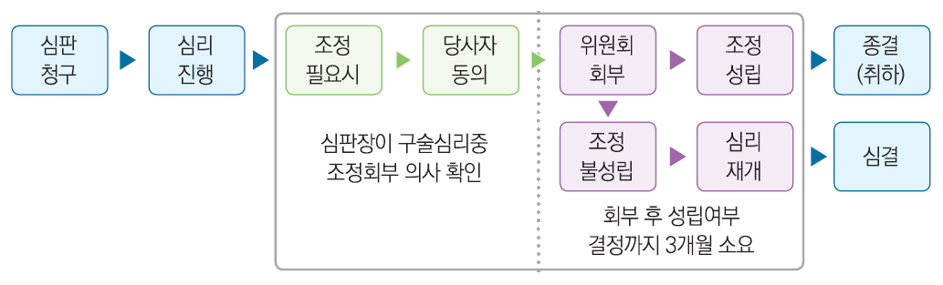
Trial and Mediation
IPTAB-connected Mediation
IPTAB
IP Mediation Committee
IPTAB
File a petition for trial
Initiate IPTAB proceedings
Mediation deemed necessary
Consent of the parties
Refer to Mediation Committee
Mediation settled
Case closed
(withdrawn)
조정
성립
The presiding IPTAB judge shall propose to mediate and confirm the parties’ consent either ① by issuing a Notice or ② during oral hearings
(submission of consent form)
Mediation failed
Resume IPTAB proceedings
IPTAB decision
조정
불성립
3 months from referral
to decision on settlement
Suspend IPTAB proceedings
Resume
IPTAB proceedings
(Trial Policy Division, IPTAB)
IPTAB formalities officer shall deliver the Notice of Referral to Mediation and copies of IPTAB documents
- 5 -

Slide 28


IP MEDIATION: WHERE DOES UKRAINE STAND TODAY?
Aurika Hrybovska
Head of Mediation Center,
Ukrainian National Office for Intellectual Property and Innovations

Slide 29
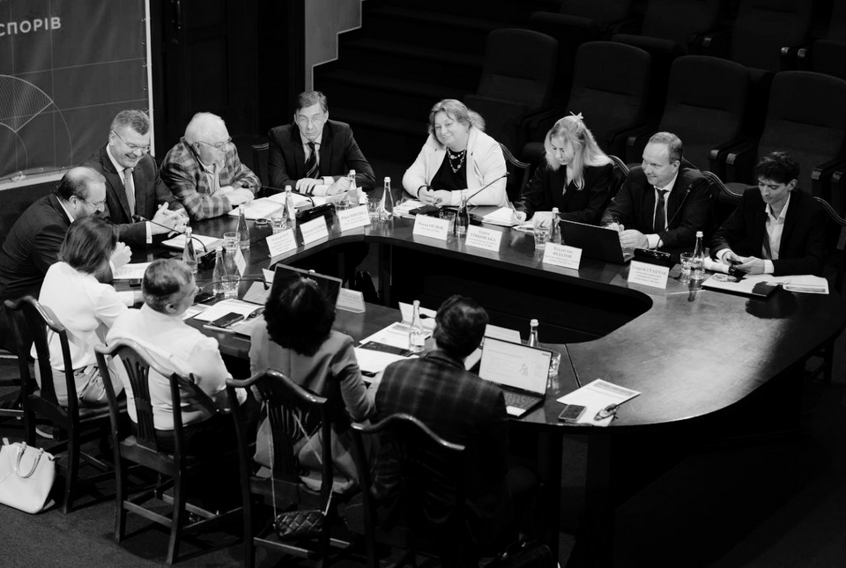
UANIPIO Mediation Center
What Is It?
UANIPIO Mediation Center - structural subdivision of UANIPIO.
UANIPIO Mediation Center - professional platform for resolving disputes through IP mediation.
The main tasks of the UANIPIO Mediation Center:
  raising awareness
  supporting the development of mediation procedures
  facilitating the organization of mediations
  training and capacity-building
  fostering cooperation with international IP institutions and organisations
IP Mediation-related Documents
Mediation Rules in IP
Regulations for Mediator Registration in IP Disputes
Professional Ethics Code
UANIPIO Mediation Center follows Ukraine’s “On Mediation” Law

Slide 30
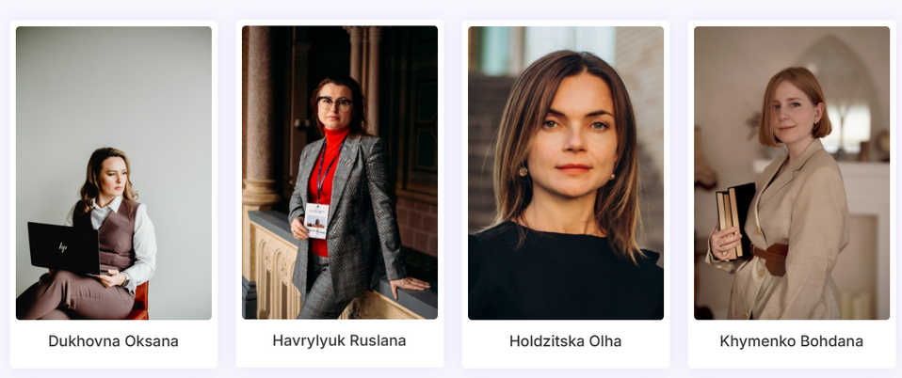
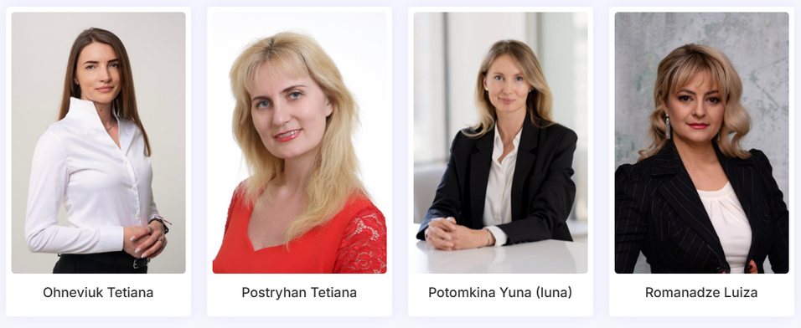
Register of IP Mediators
The Register of IP Mediators:
Online directory managed by the Mediation Center.
Currently, 18 mediators qualified for IP cases.
Expansion of mediators list ongoing.
Party/Parties submit a mediation request to the Center.
Parties select a mediator from the Register of IP Mediators.

Slide 31
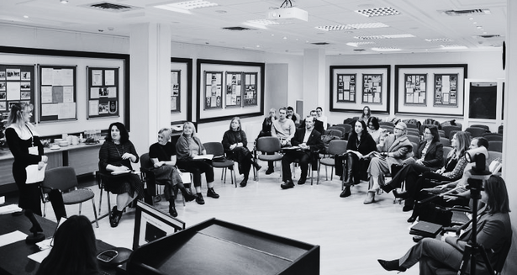

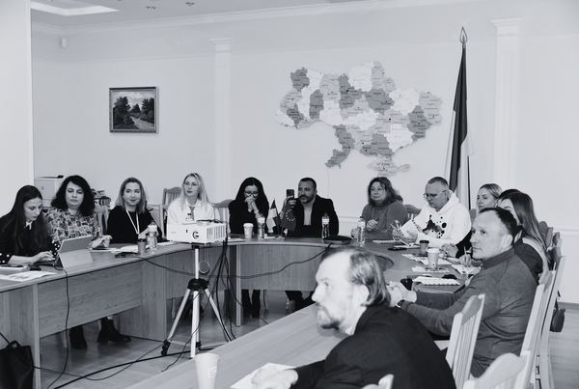
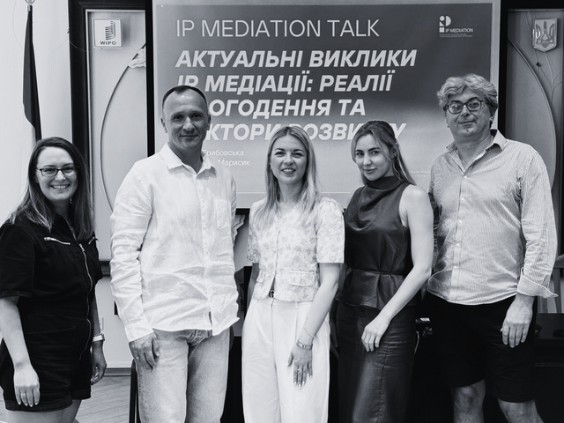
Center has implemented
the following projects
Discussion Club
Research project
Media projects
IP Mediation Talk
Meetings of professionals focused on advancing IP mediation.
Started a research project on "Practice of Implementing IP Mediation: Study of Foreign Experience”.
Produced and published:
A set of 19-Videos
The project "Case Simulation of IP Mediation: Poet vs. Blogger”.
Introduced a new series of regular meetings with mediators called IP Mediation Talk.

Slide 32



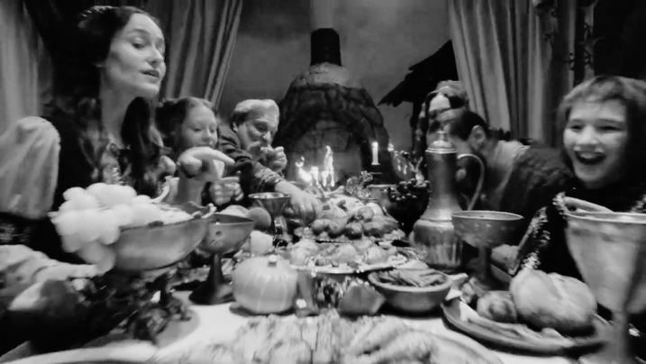
First Public
IP Mediation Case in Ukraine
Myronivsky Hliboproduct (MHP) VS
Creative agency Vandog Agency
Subject-matter of the dispute:
The founder of a creative agency accused a major agribusiness company of stealing the idea for a commercial. The company denied the allegation but admitted to certain ethical shortcomings.
Both parties decided to resolve the matter through the UANIPIO Mediation Center.
In accordance with the established procedure, and after jointly selecting a mediator from the Register of IP mediators, the parties reached a settlement through mediation.
Result of IP mediation:
The parties confirmed the absence of mutual claims and concluded an agreement on further cooperation. They also agreed on jointly developing recommendations to improve tender procedures in the marketing and creative industries.
This information is being disclosed publicly with the consent of both parties, who agreed to make the mediation process public.

Slide 33

Selection of Mediation Centres in IP cases
Perspective of a French IP Practitioner
Virginie LEHOUX
Cabinet BENECH
Avocats et Conseils en Propriété Industrielle

Slide 34
01 . What is the current IP mediation landscape in France ?
Institutional Mediation
No mediation services available at INPI France
Judicial Mediation
Voluntary, except of injunctions, where parties must attend an information meeting with a mediator
Conventional Mediation
Mediation outside a lawsuit (before, in parallel or after)
In opposition/cancellation proceedings, parties may contact „Le Médiateur des Entreprises“
Confidential but costs involved
Confidential and free of charge
IP-specialised mediator appointed by the judge from a list administered by the Court of Appeal
Confidential but costs involved
Mediation integrated into a lawsuit
Several mediation centres or independent mediators with IP expertise available, e.g. ICC, AEM, CMAP, IEAM, WIPO

Slide 35
02 . When to decide in favour of mediation ?
Growing interest of French Government for mediation : several recent legislative changes to encourage mediation
Mediations in IP cases before the Paris First Instance Court and Court of Appeal have risen significantly in the past five years
Judicial mediation is generally proposed by the judge at various stages of the proceedings. In some cases, a party may also suggest it.
Mediation may avoid litigation, but litigation can also lead to mediation
⇒ Lawyers must assess the best stage for mediation

Slide 36
03 . How to select a mediation centre or a mediator for IP cases ?
Main criteria to choose a mediation centre:
  Type of IP rights involved: patent, trade mark, copyright, etc.
  International / national dispute(s):
    Nationality and cultural background of the parties
    Territory of exploitation
  Key Financial Factors: dispute value, client resources, costs of mediation
  Previous experience with the centre
  Facilities offered by the centre
  Main criteria to choose a mediator:
  IP experience and reputation
  Impartiality / conflict check
  Availability
5

Slide 37

THANK YOU

